Slide 1
Computer Graphics 6th Recitation “OpenGL: Drawing”
Anna Shtengel
Based on slides by Michael Litvin
20.04.2013

Slide 2
Today!
3D transformations
OpenGL: Drawing
RGB Cube

Slide 3
Transformations
Upgrading to 3D

Slide 4

1.
Given 6 lines in 3D space
Three lines are parallel to vector $v$ and go through points $P_{1},P_{2},P_{3}$
Three lines are parallel to vector $w$ and go through points $Q_{1},Q_{2},Q_{3}$
Find an affine transformation $T$ that maps the first 3 lines to the last 3 lines, respectively.

Slide 5










2.
Given a normalized vector $v$ in 3d space, find a linear transformation $R$ that would rotate any point $p$ around $v$ by angle $α$.
Find its inverse $R^{−1}$.
$$z$$
$$p$$
$$v$$
$$q$$
$$α$$
$$θ$$
$$φ$$
$$y$$
$$x$$

Slide 6




3.
Given an ellipsoid centered at point $p$ and has axes directed at (orthonormal vectors) $v_{1},v_{2},v_{3}$ with lengths $l_{1},l_{2},l_{3}$. Find an affine transformation that will transform it into a unit sphere.
$$v_{1}$$
$$p$$
$$v_{2}$$

Slide 7

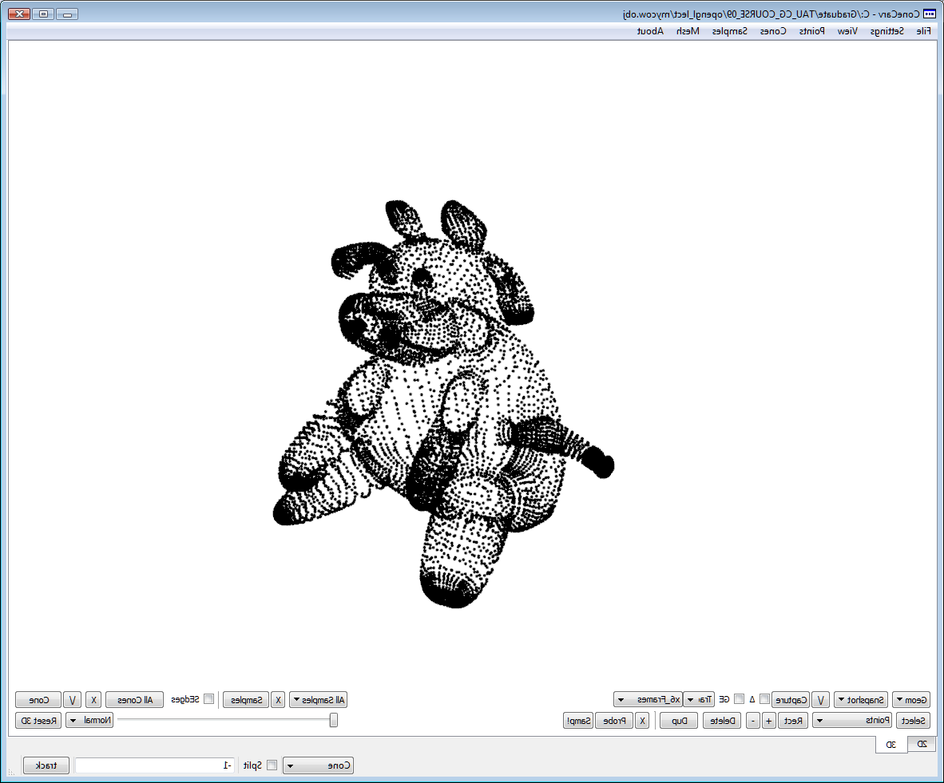
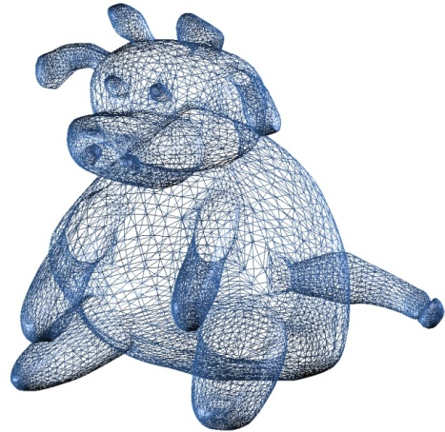
Drawing
Points, and lines, and polygons, oh my!
Based on slides by Alan Lerner: http://www.cs.tau.ac.il/~alan/Teaching/OpenGL/OpenGL.htm

Slide 8
Drawing in OpenGL
OpenGL supports drawing of 3 types of primitives
Dots
Lines
Polygons (actually triangles)
A drawn primitive is immediately processed by the graphical pipeline
Pipeline configured using OpenGL states

Slide 9
OpenGL Graphical Pipeline
3D Geometric Primitives
3D Geometric Primitives
Modeling
Transformation
Model-View
Transformation
Lighting
Lighting
Viewing
Transformation
Projection
Transformation
Projection
Transformation
Clipping
Clipping
Scan
Conversion
Scan
Conversion
Frame Buffer
Frame Buffer
Notes:
http://upload.wikimedia.org/wikipedia/commons/b/bb/Pipeline_OpenGL_%28en%29.png

Slide 10
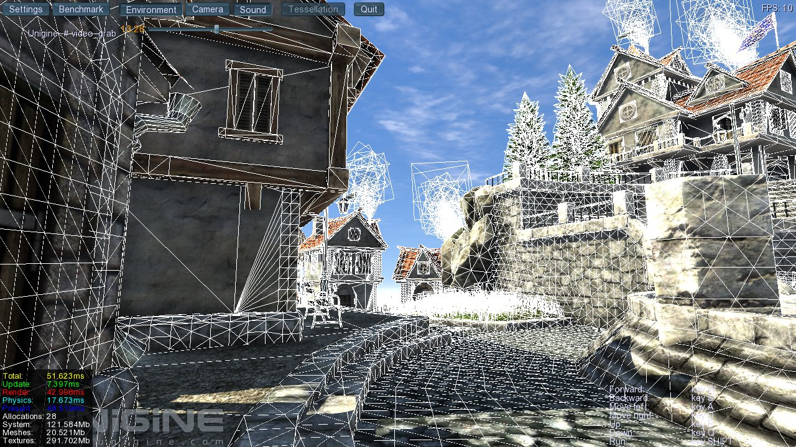
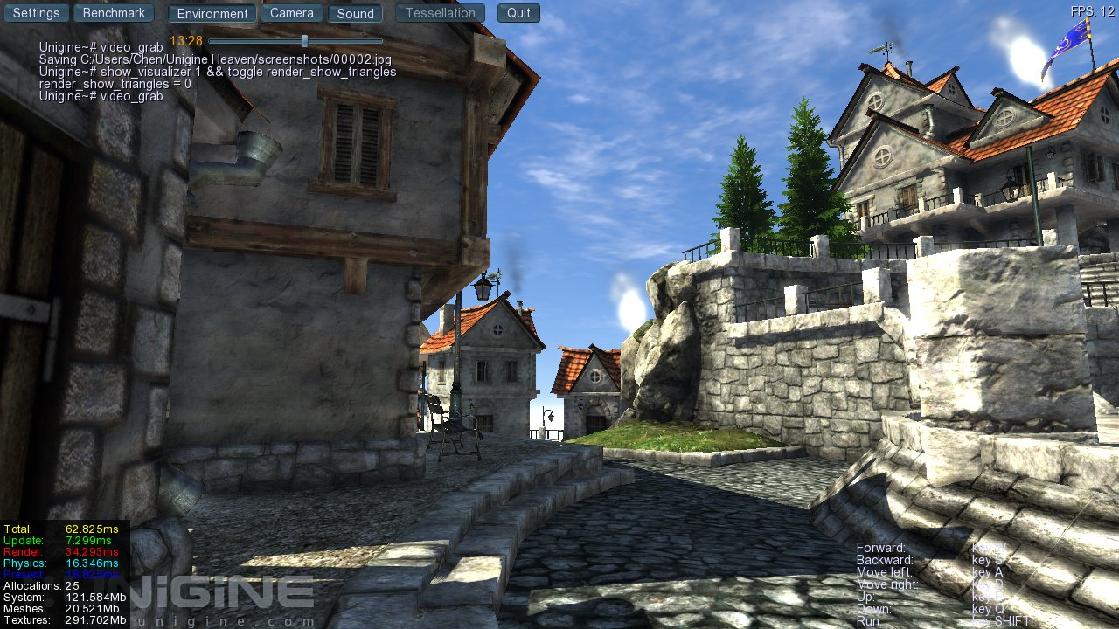

Slide 12
Graphical Pipeline
We Are Here
3D Geometric Primitives
Modeling
Transformation
Lighting
Viewing
Transformation
Projection
Transformation
Clipping
Scan
Conversion
Frame Buffer

Slide 13
Vertex
Vertex – קודקוד
The basic building block in OpenGL
Vertices completely define the OpenGL primitives:
A Dot is defined by a single vertex
A Line is defined by two vertices
A Polygon is defined by three or more vertices

Slide 14
Specifying Vertices
void glVertex{234}{sifd}[v](TYPE coords);
Default z value is 0.
Default w value is 1.
Calls to glVertex*() are only effective between a glBegin() and glEnd() pair.

Slide 15
Example: Drawing a Polygon
glBegin – Start drawing
glEnd – End drawing
glBegin(GL_POLYGON);
glVertex2f(0.0, 0.0);
glVertex2f(4.0, 0.0);
glVertex2f(6.0, 1.5);
glVertex2f(4.0, 3.0);
glVertex2f(0.0, 3.0);
glEnd();

Slide 16
Point
Specified by a single vertex
Occupies at least a single pixel.
Many points (with different coordinates) can be rendered at the same pixel
A Point

Slide 17
Line
Defined by 2 vertices
Occupies pixels on an 8-connected line between the 2 vertices
A Vertex
A Vertex
A Line Segment

Slide 18
Polygons
The area enclosed by a single closed loop of line segments defines a polygon.

Slide 19
Polygon Restrictions
Polygons must be convex.
The edges of OpenGL polygons cannot intersect.
Can’t have holes.
If the vertices of the polygon do not lie on the same plane, you can get unexpected results!
It’s your responsibility to check that.
THIS IS WHY WE PREFER TRIANGLES
Notes:
לא איסורים - המלצות

Slide 20
Invalid Polygons

Slide 21
glBegin() & glEnd()
void glBegin(GLenum mode);
Marks the beginning of a vertex-data list that describes a geometric primitive.
void glEnd(void);
Marks the end of a vertex-data list.
glVertex allowed only between glBegin, glEnd

Slide 22
Geometric Drawing Primitives
glBegin(???);
{
glVertex2fv(V₀);
glVertex2fv(V₁);
glVertex2fv(V₂);
glVertex2fv(V₃);
glVertex2fv(V₄);
glVertex2fv(V₅);
glVertex2fv(V₆);
glVertex2fv(V₇);
}
glEnd();
V₅
V₄
V₆
V₃
V₇
V₂
V₀
V₁

Slide 23
GL_POINTS
glBegin(GL_POINTS);
{
glVertex2fv(V₀);
glVertex2fv(V₁);
glVertex2fv(V₂);
glVertex2fv(V₃);
glVertex2fv(V₄);
glVertex2fv(V₅);
glVertex2fv(V₆);
glVertex2fv(V₇);
}
glEnd();
V₅
V₄
V₆
V₃
V₇
V₂
V₀
V₁
Draws a point at each of the n specified vertices.

Slide 24
GL_LINES
glBegin(GL_LINES);
{
glVertex2fv(V₀);
glVertex2fv(V₁);
glVertex2fv(V₂);
glVertex2fv(V₃);
glVertex2fv(V₄);
glVertex2fv(V₅);
glVertex2fv(V₆);
glVertex2fv(V₇);
}
glEnd();
V₅
V₄
V₆
V₃
V₇
V₂
V₀
V₁
Draws a line segment between V_{i} and V_{i+1}, where i is even. If n is odd then the last vertex is ignored.

Slide 25
GL_LINE_LOOP
glBegin(GL_LINE_LOOP);
{
glVertex2fv(V₀);
glVertex2fv(V₁);
glVertex2fv(V₂);
glVertex2fv(V₃);
glVertex2fv(V₄);
glVertex2fv(V₅);
glVertex2fv(V₆);
glVertex2fv(V₇);
}
glEnd();
V₅
V₄
V₆
V₃
V₇
V₂
V₀
V₁
Draws n line segments in a loop.

Slide 26
GL_TRIANGLES
glBegin(GL_TRIANGLES);
{
glVertex2fv(V₀);
glVertex2fv(V₁);
glVertex2fv(V₂);
glVertex2fv(V₃);
glVertex2fv(V₄);
glVertex2fv(V₅);
glVertex2fv(V₆);
glVertex2fv(V₇);
}
glEnd();
V₅
V₄
V₆
V₃
V₇
V₂
V₀
V₁
Draws a triangle for vertices V_{i}-V_{i+1}-V_{i+2}, where i = 0,3,6 … If n is not a multiple of 3, the remaining vertices are ignored

Slide 27
GL_QUADS
glBegin(GL_QUADS);
{
glVertex2fv(V₀);
glVertex2fv(V₁);
glVertex2fv(V₂);
glVertex2fv(V₃);
glVertex2fv(V₄);
glVertex2fv(V₅);
glVertex2fv(V₆);
glVertex2fv(V₇);
}
glEnd();
V₅
V₄
V₆
V₃
V₇
V₂
V₀
V₁
Draws a quads for vertices V_{i}-V_{i+1}-V_{i+2}V_{i+3}, where i = 0,4,8 … If n is not a multiple of 4, the remaining vertices are ignored.

Slide 28
GL_POLYGON
glBegin(GL_POLYGON);
{
glVertex2fv(V₀);
glVertex2fv(V₁);
glVertex2fv(V₂);
glVertex2fv(V₃);
glVertex2fv(V₄);
glVertex2fv(V₅);
glVertex2fv(V₆);
glVertex2fv(V₇);
}
glEnd();
V₅
V₄
V₆
V₃
V₇
V₂
V₀
V₁
Draws a polygon over the vertices.

Slide 29
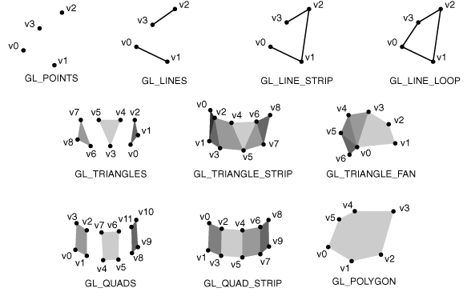
Available Modes

Slide 30
Vertex Attributes
Only a few OpenGL functions can be called between glBegin() and glEnd()
Functions that change vertex attributes
E.g. vertex color
GL Functions allowed inside: (but also outside)
glColor()
glNormal()
glTexCoord()
…

Slide 31
Example: Vertex Color Attribute
glColor3f(1.0,1.0,0.0);
glBegin(GL_QUADS);
glVertex3f(0.0,0.0,0.0);
glVertex3f(1.0,0.0,0.0);
glVertex3f(1.0,1.0,0.0);
glVertex3f(0.0,1.0,0.0);
glEnd();

Slide 32
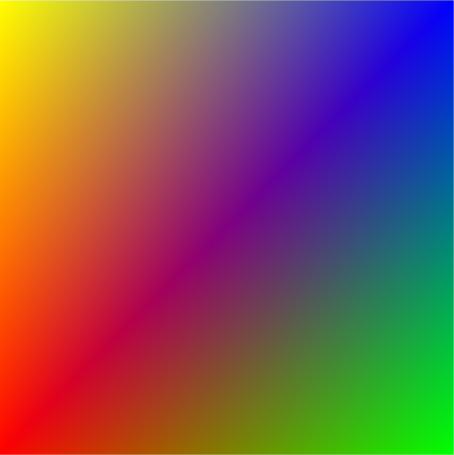
Example: Vertex Color Attribute
glBegin(GL_QUADS);
glColor3f (1.0,0.0,0.0);
glVertex3f(0.0,0.0,0.0);
glColor3f (0.0,1.0,0.0);
glVertex3f(1.0,0.0,0.0);
glColor3f (0.0,0.0,1.0);
glVertex3f(1.0,1.0,0.0);
glColor3f (1.0,1.0,0.0);
glVertex3f(0.0,1.0,0.0);
glEnd();

Slide 33
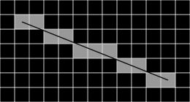
Rasterization Details
OpenGL gives some control on how primitives are drawn by the Rasterizer
Namely size, width and pattern of points and lines
Also relevant: smoothing and anti-aliasing
later

Slide 34
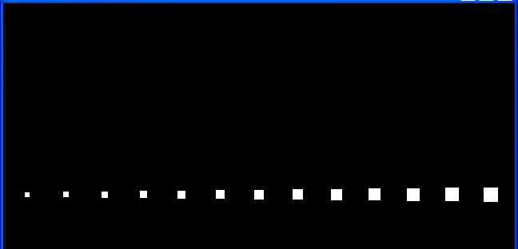
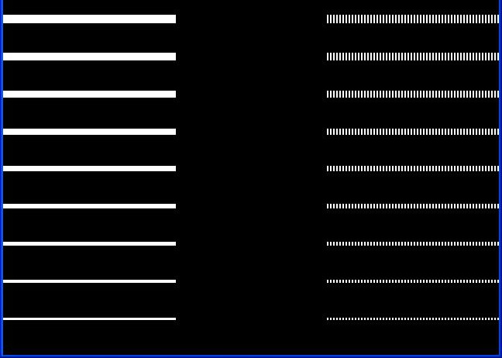
Point & Line Rasterization
Points:
glPointSize(float size)
Lines:
glLineWidth(float width)
glLineStipple (factor, pattern)
Implementation specifics:
GL_ALIASED_LINE_WIDTH_RANGE
GL_POINT_SIZE_RANGE

Slide 35
Polygon Details
void glPolygonMode(GLenum face, GLenum mode);
Controls the drawing mode for a polygon's front and back faces.
Drawing mode can be GL_POINT, GL_LINE, GL_FILL.
Face can be GL_FRONT, GL_BACK

Slide 36
Front Facing Polygons
Unless specified otherwise:
Counterclockwise Order ⬄ Front Face.
Clockwise Order ⬄ Back Face.
V₂
V₁
V₁
V₂
V₀
V₀

Slide 37
glFrontFace
void glFrontFace(GLenum mode);
Specifies the orientation of front-facing polygons.
GL_CW and GL_CCW are accepted.
The initial value is GL_CCW.

Slide 38
Summary
We saw basic drawing techniques
glBegin(), glEnd(), glVertex()
These methods are simple to use
Faster alternatives shown later this course
Didn’t talk about:
Transformations
That’s next!
Hidden surface removal

Slide 39
Color Buffers
More next week

Slide 40
Framebuffer Buffers
OpenGL uses several buffers for frame pixels:
Color Buffer – Stores color for each pixel
Depth Buffer – Stores depth value for each pixel.
Stencil Buffer – Stores multi-purpose value for each pixel
Accumulation Buffer – Allows color averaging
Framebuffer
Color Buffer
Front Left
Front Right
Back Left
Back Right
Depth Buffer
Stencil Buffer
Accumulation Buffer

Slide 41
Double Buffering
The Back Buffer
The Front Buffer
Implicit in JOGL

Slide 42
Color Buffers
Stereoscopic implementation – supports left and right buffer
If not, the Left is used
Double buffering support Back buffers
If not, Front is used
Anyway Left-Front is guaranteed
Check availability with glGetBooleanv() with GL_STEREO, GL_DOUBLEBUFFER
Color Buffer
Front Left
Front Right
Back Left
Back Right

Slide 43
Clearing the Color Buffer
void glClear(mask)
Clear color buffer with mask = GL_COLOR_BUFFER_BIT
void glClearColor(float r, float g, float b, float alpha)
Color used to fill the color buffer

Slide 44
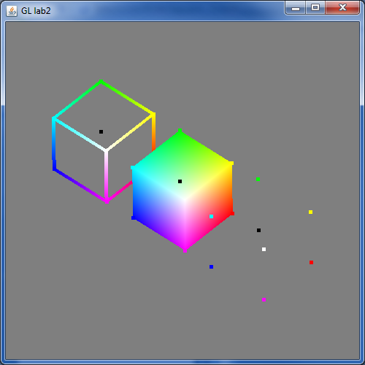
RGB Cube
OpenGL demonstration

